Slide 1

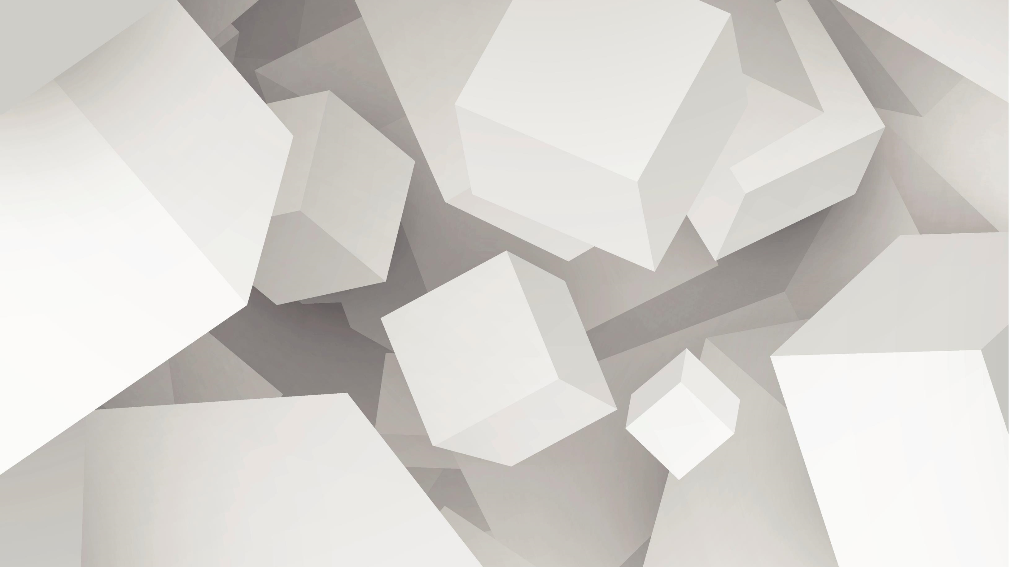
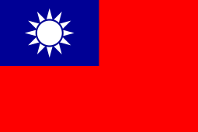
Fantastic Chess Variants and How to Play Them
Vel (Tien-Yun) Wu
巫天允

Slide 2
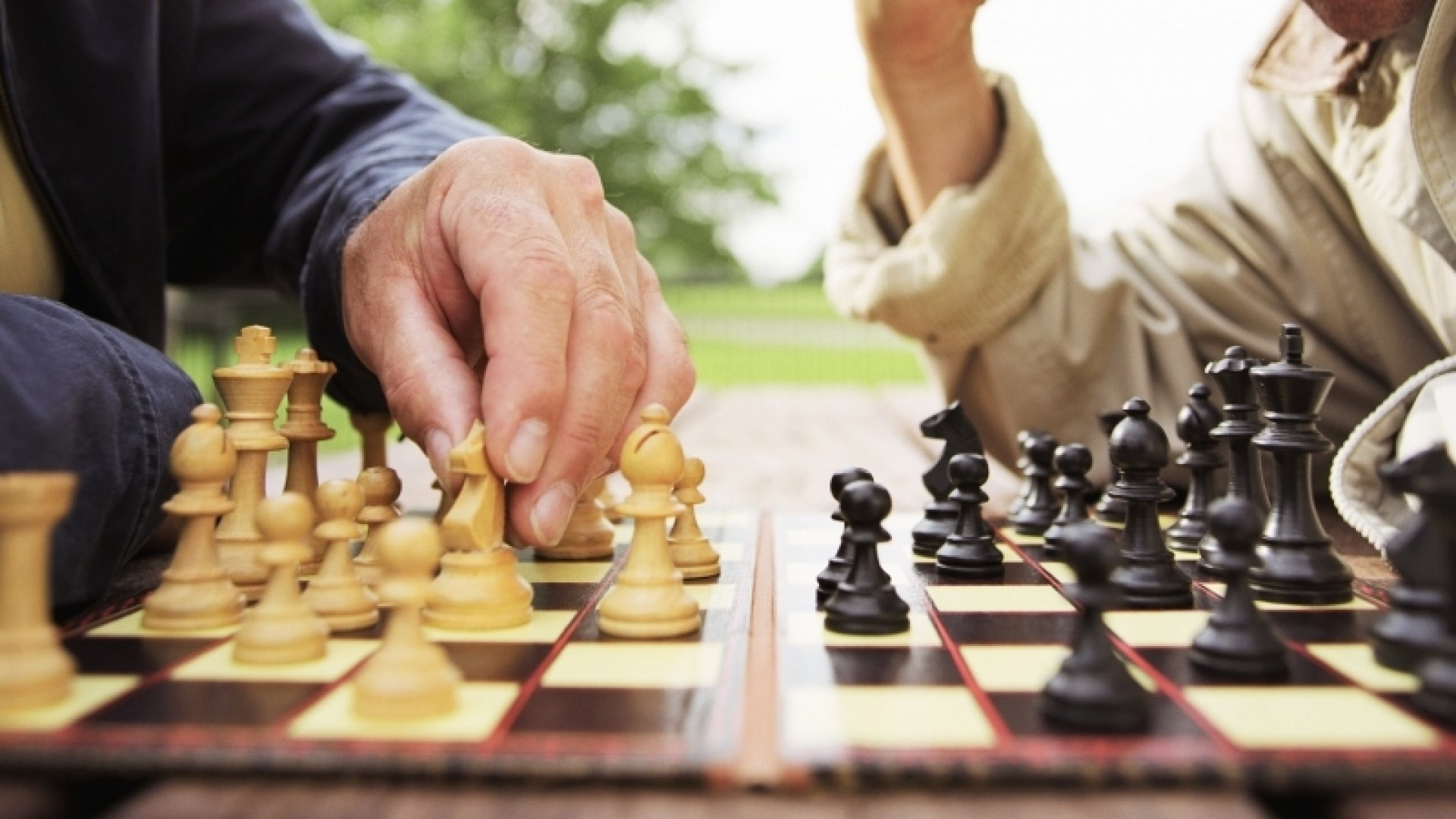

Contents
Why this topic?
Data Structures
Movement Mechanics
Minimax AI logic
Minichess variants
Challenges and Works In Progress

Slide 3
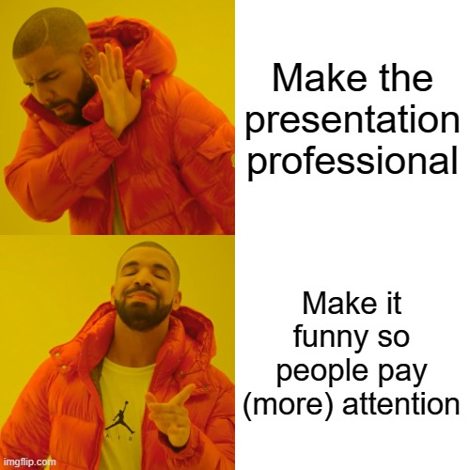
Disclaimer
Some content in this presentation might be satirical or cringe
They are purely for attention retention purposes and do not reflect the presenter’s real-world views and/or ideologies

Slide 4
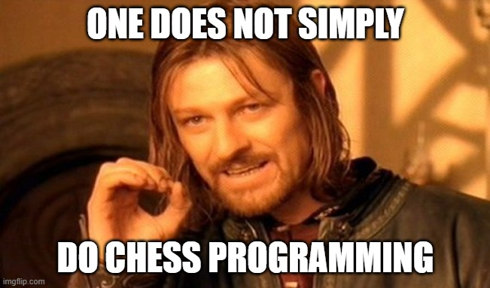
Why this topic?

Slide 5
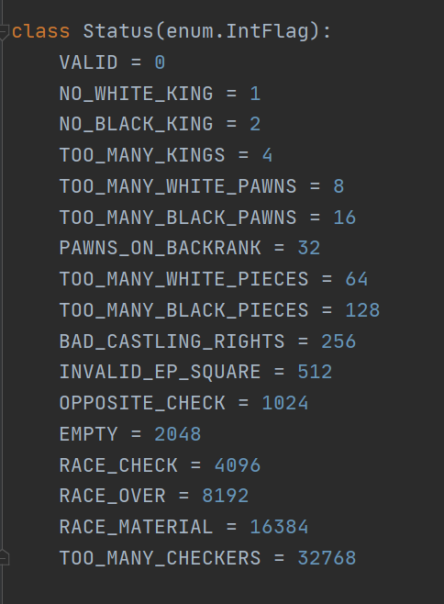
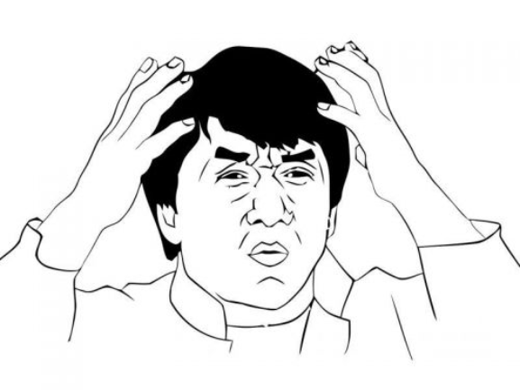
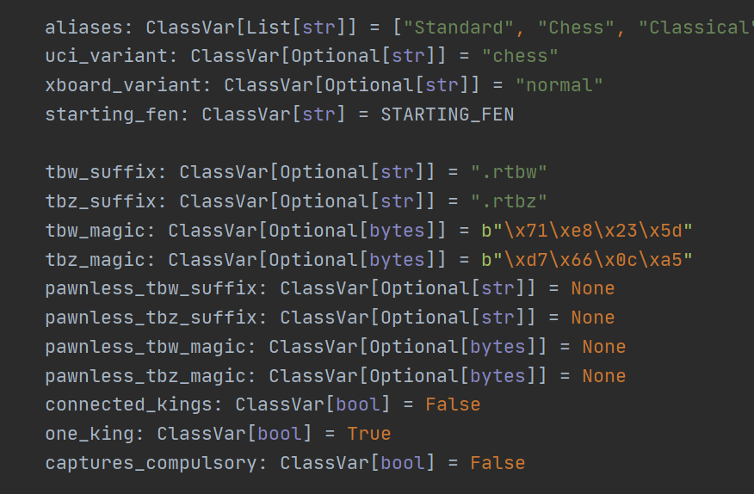
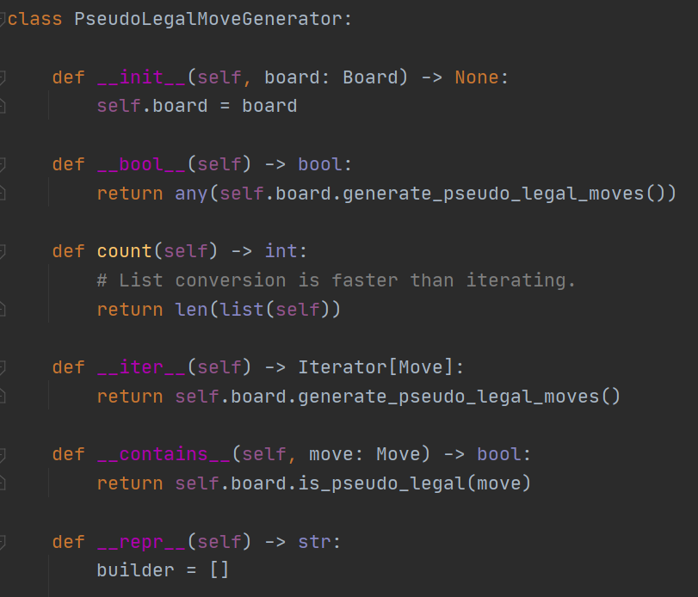
Why this topic?
Surely a chess program would be super easy if I just used a published chess engine, right?
..
…right??
Screenshots of the Python-Chess library

Slide 6
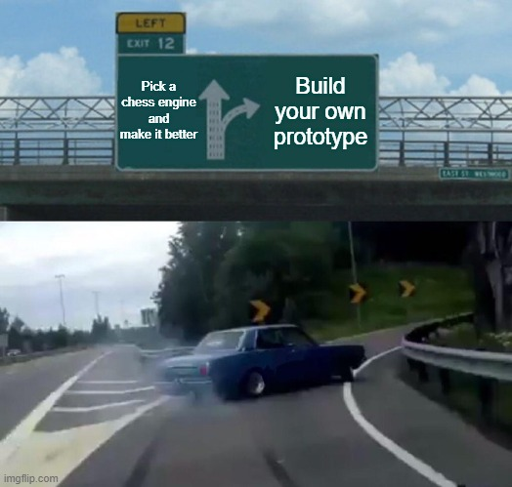
Why this topic?
Existing Chess AIs or simulators written in Python (that I’m aware of):
1. Rely heavily on the Python-Chess library:
https://python-chess.readthedocs.io/en/latest/
2. Do not handle Minichess
3. Do not support custom rules without breaking some other things

Slide 7
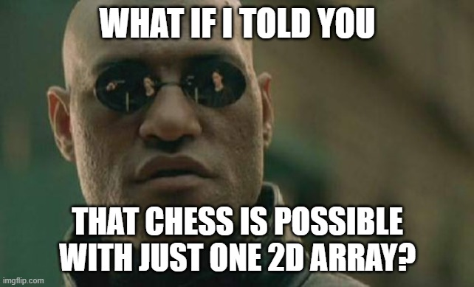
Data Structure

Slide 8
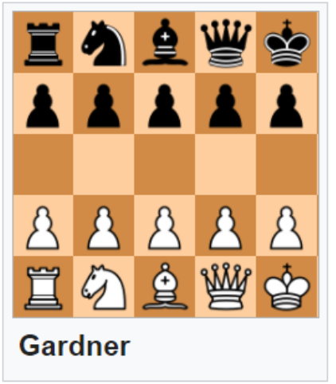
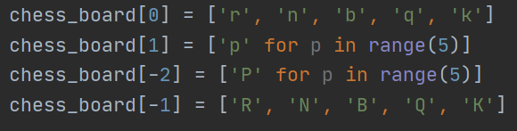
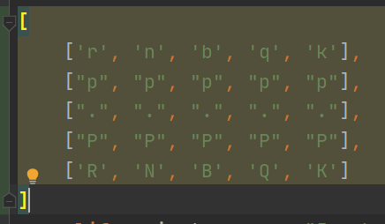
Data Structure

Slide 9

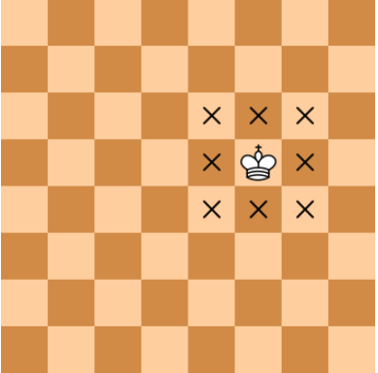
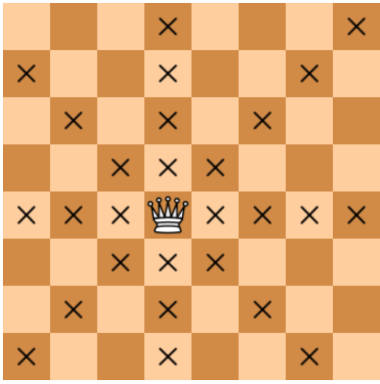
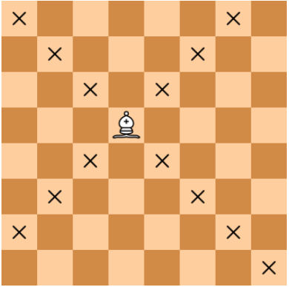
Movement Mechanics
King
♚ White: “K”
♔ Black: “k”
Queen
♛ White: “Q”
♕ Black: “q”
Bishop
♝White: “B”
♗Black: “b”

Slide 10
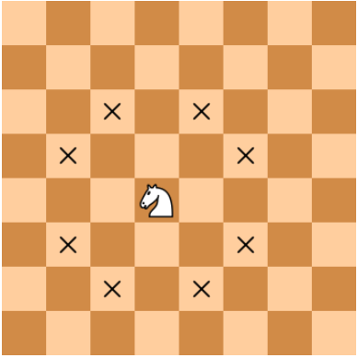
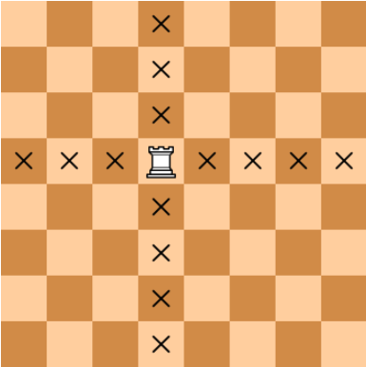
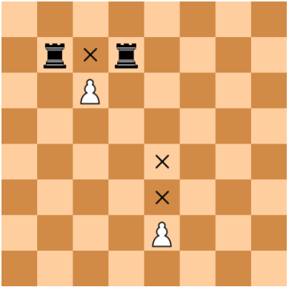
Movement Mechanics
Knight
♞White: “N”
♘Black: “n”
Rook
♜White: “R”
♖Black: “r”
Pawn
♙White: “P”
♙Black: “p”

Slide 11
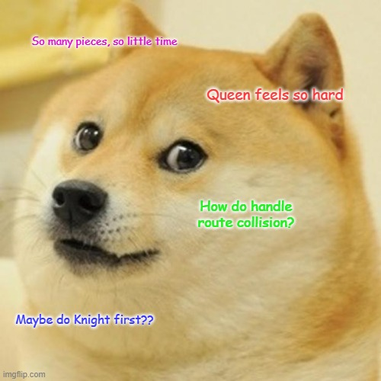
Movement Mechanics

Slide 12
Movement Mechanics
In the next slides, you will see each piece movement coded, sorted by developed first to last

Slide 13
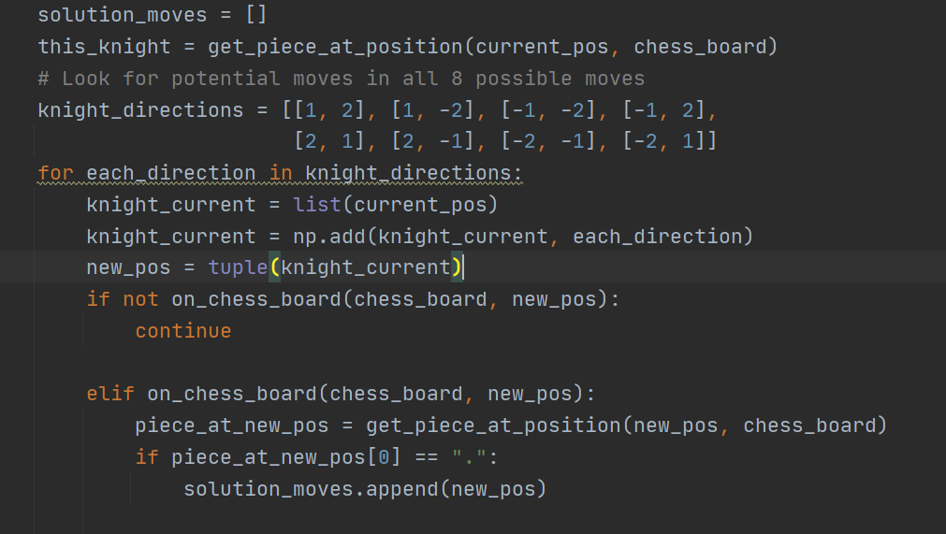
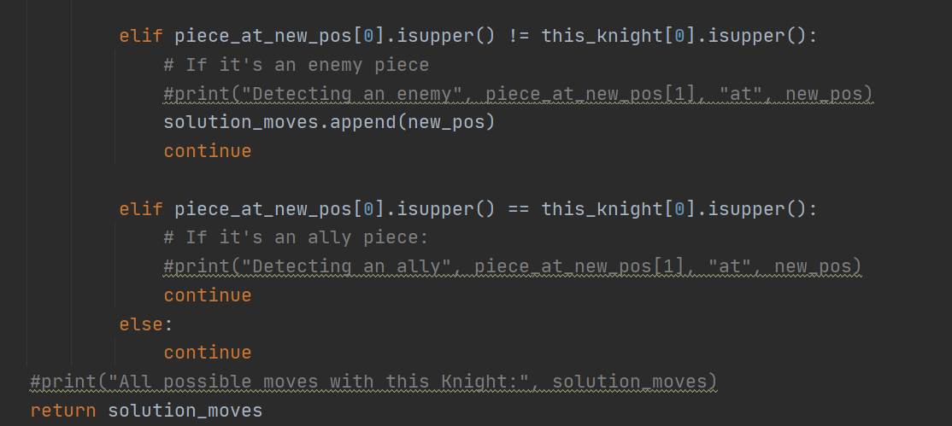
Movement Mechanics
Knight

Slide 14
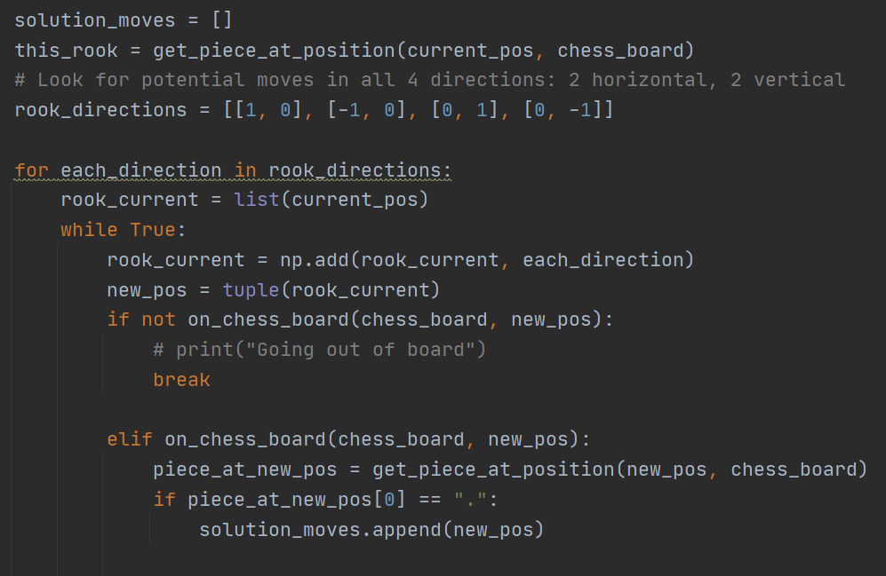
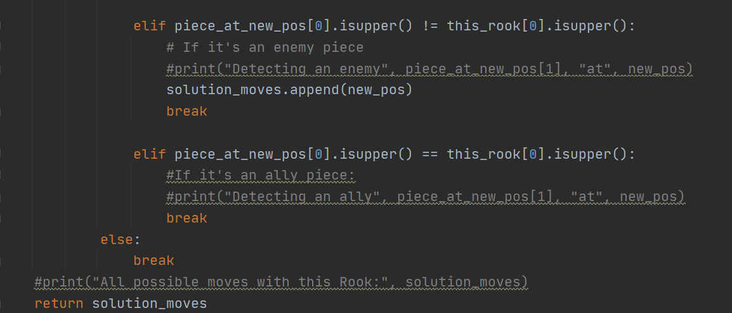
Movement Mechanics
Rook

Slide 15
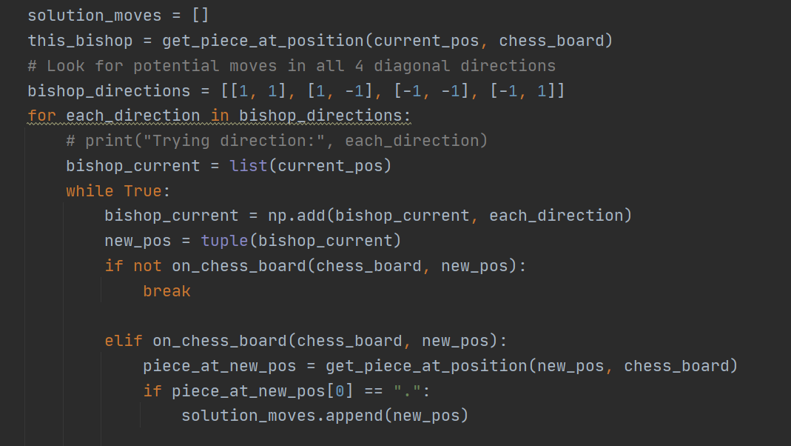
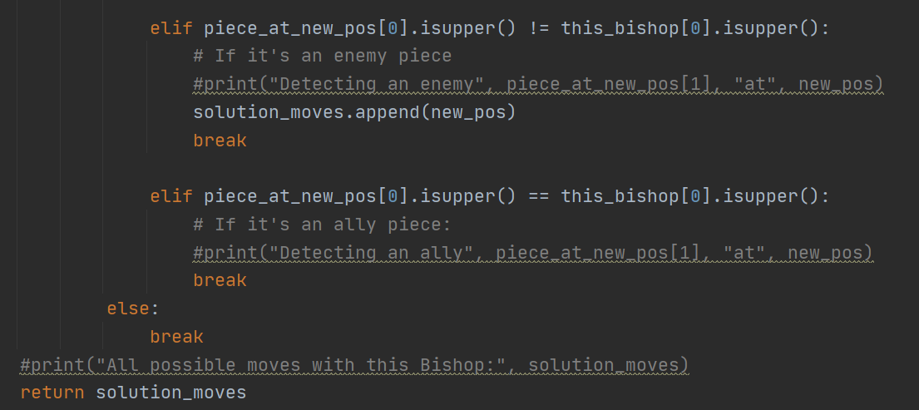
Movement Mechanics
Bishop

Slide 16
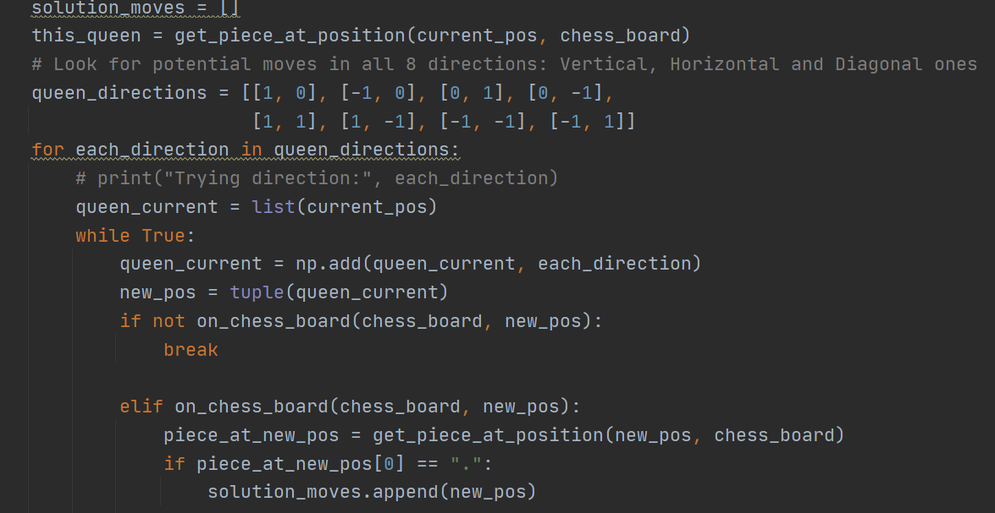
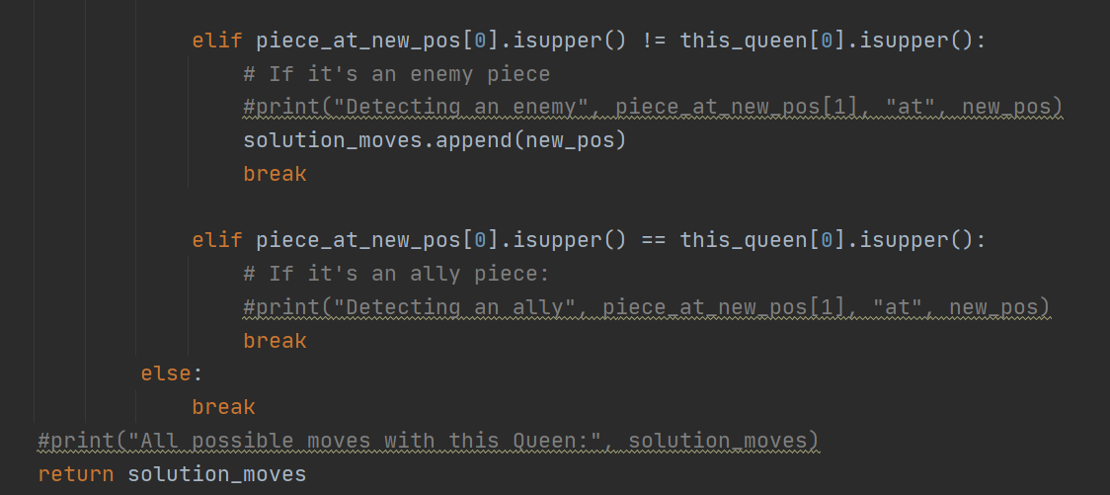
Movement Mechanics
Queen = Bishop + Rook

Slide 17
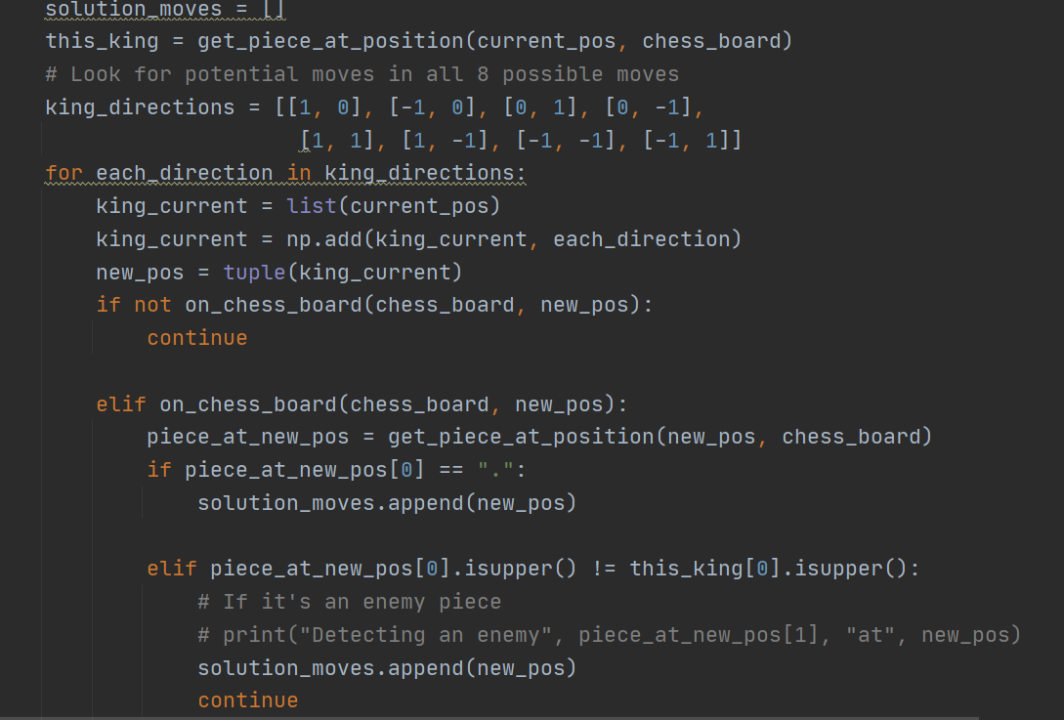
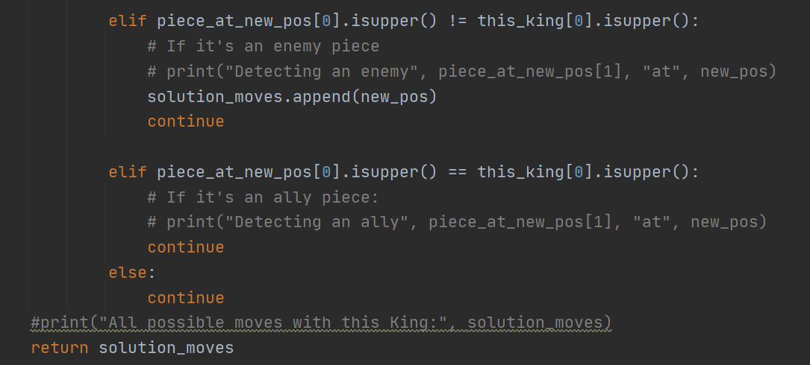
Movement Mechanics
King

Slide 18

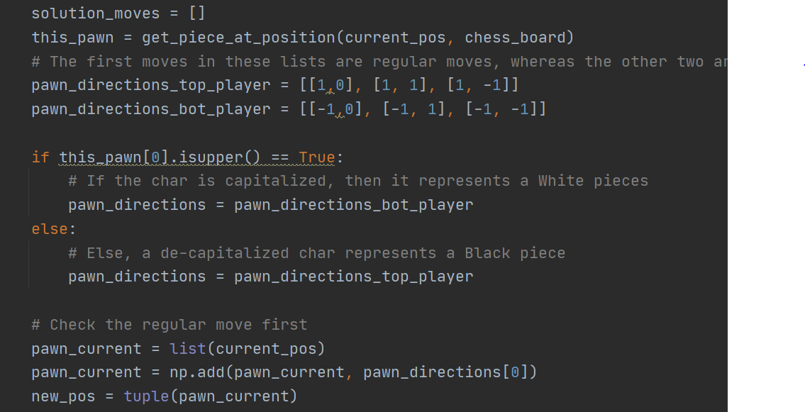
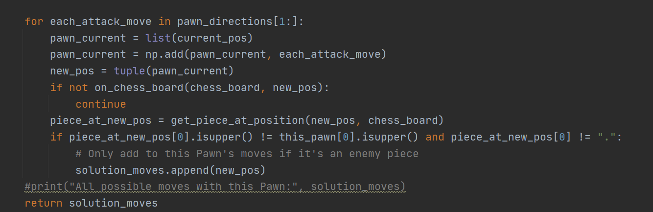
Movement Mechanics
Pawn

Slide 19
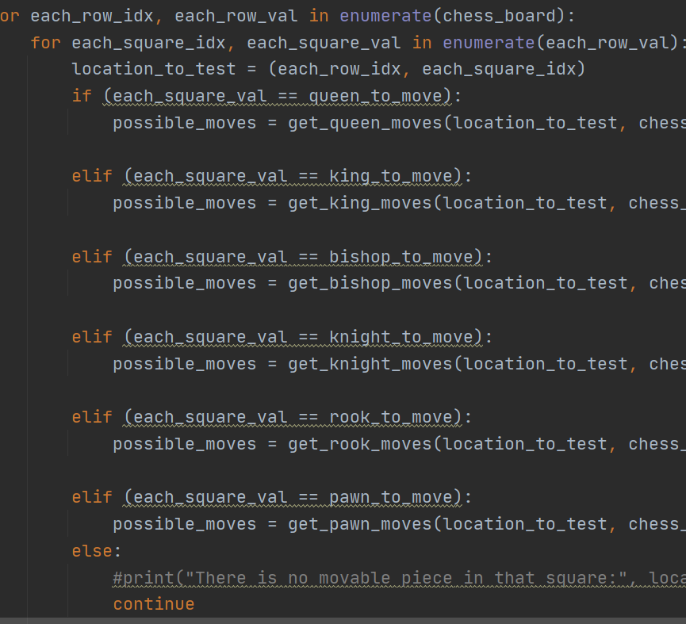
Minimax AI logic
First, generate all possible moves

Slide 20
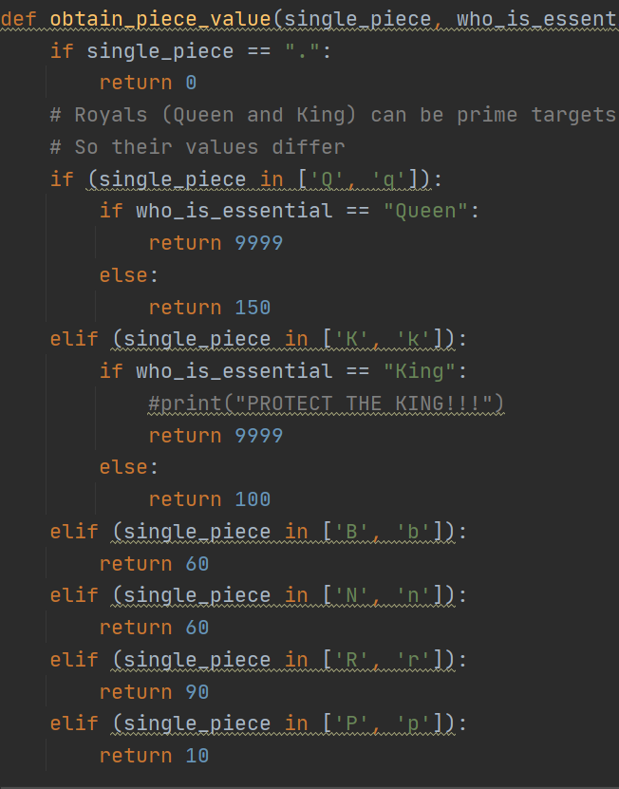
Minimax AI logic
Then obtain piece value for each possible board

Slide 21
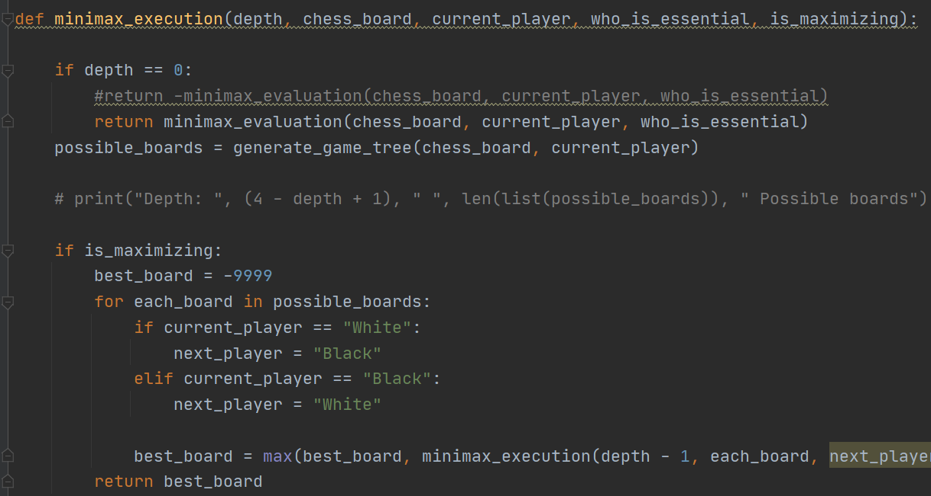
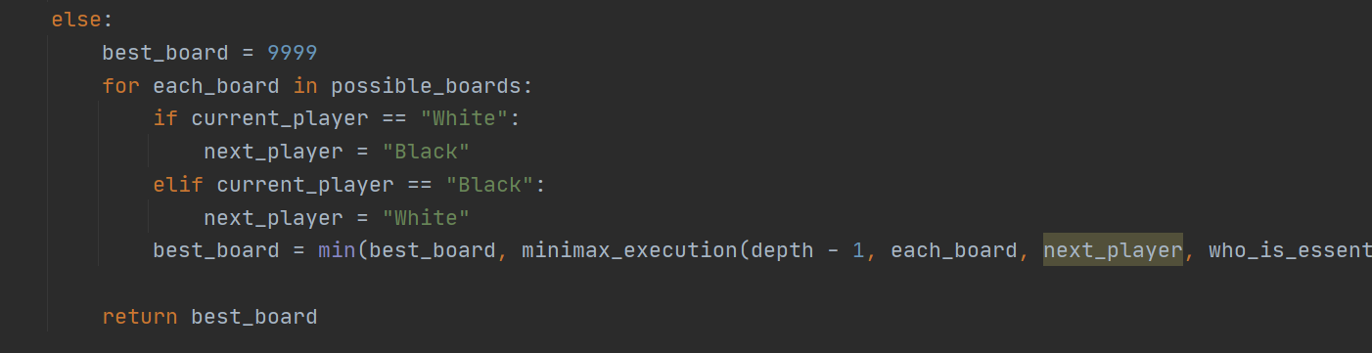
Minimax AI logic
Then switch between both players as they each try to:
Maximize own score
Minimize opponent score

Slide 22
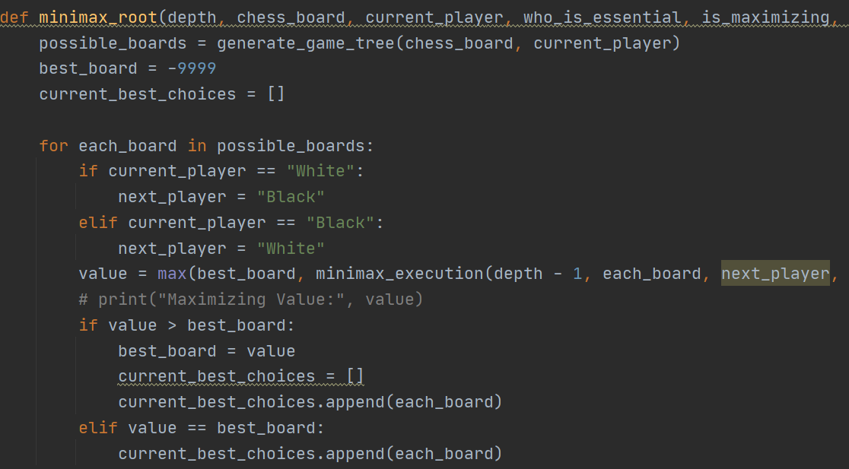
Minimax AI logic
Then wrap the execution of this logic inside a structure that recurs for:
As many times as the depth of Minimax

Slide 23
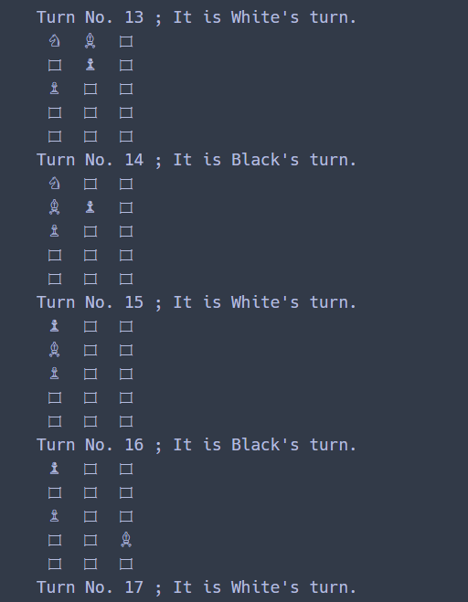
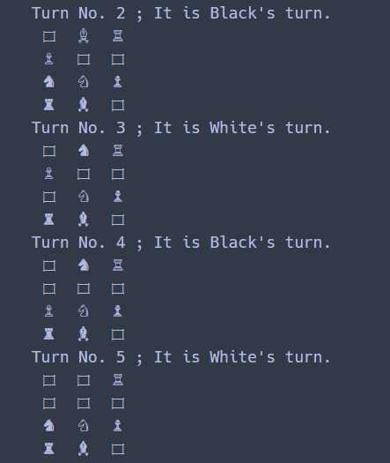

Slide 24
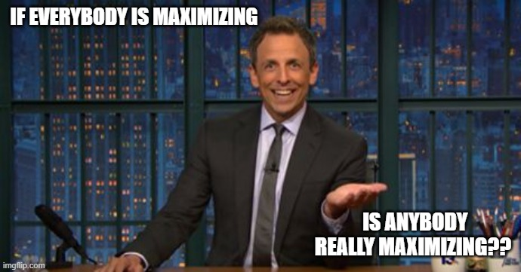
Minimax AI logic
But…

Slide 25
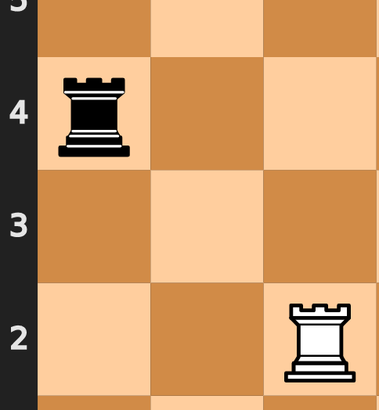
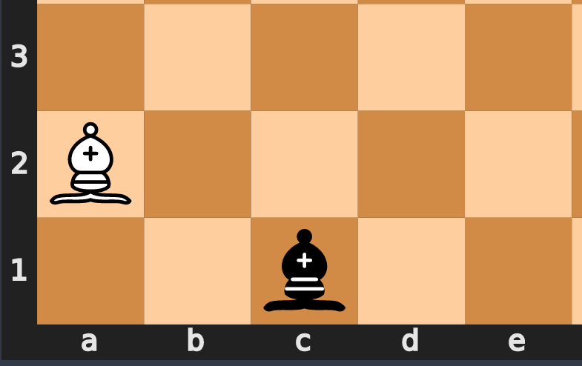
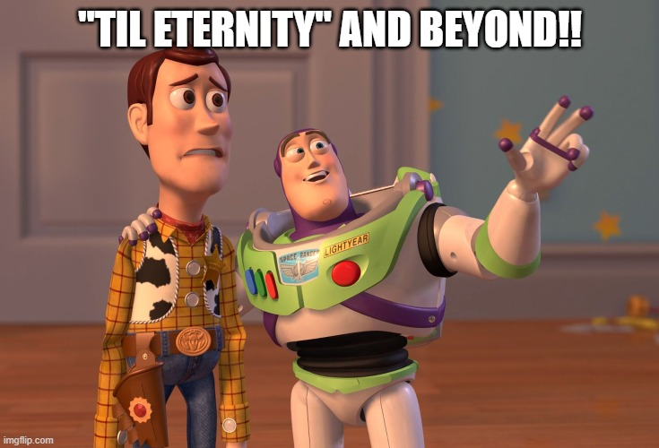
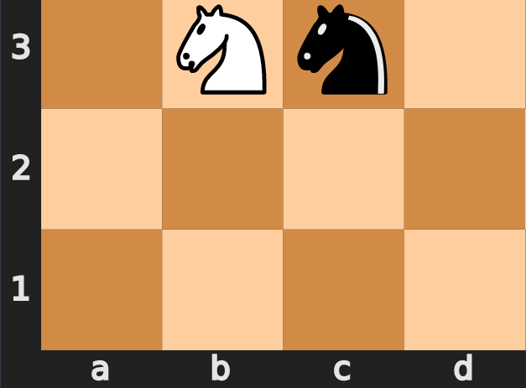
Minimax AI logic
Sometimes, games don’t end themselves

Slide 26
Minimax AI logic
Therefore, there needs to be something in move generation that:
Prevents repetition
Ends the game early if it’s caught in a loop

Slide 27
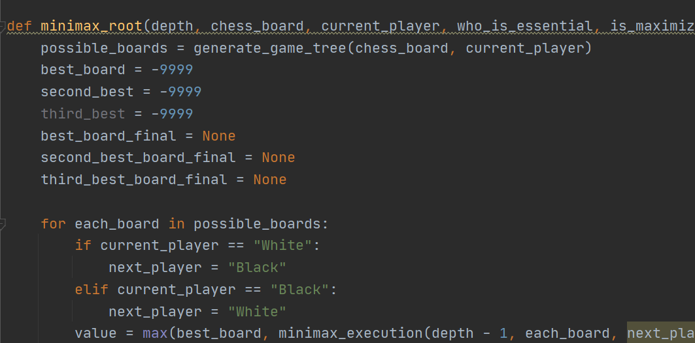
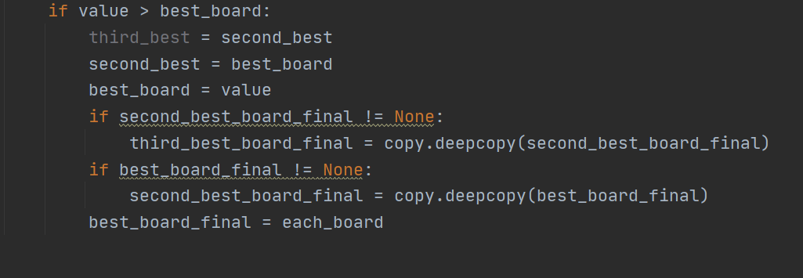
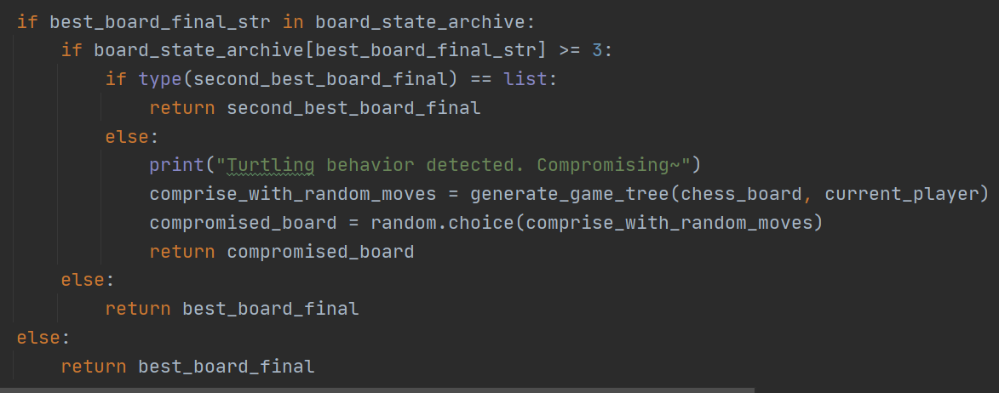
Minimax AI logic
Minimax Root, 1st version:
Weaknesses:
AI resorts to either 2nd best or 3rd best moves to avoid repetition
Requires redundant local variables
Deepcopy uses too much memory space, notably so on bigger maps/boards

Slide 28
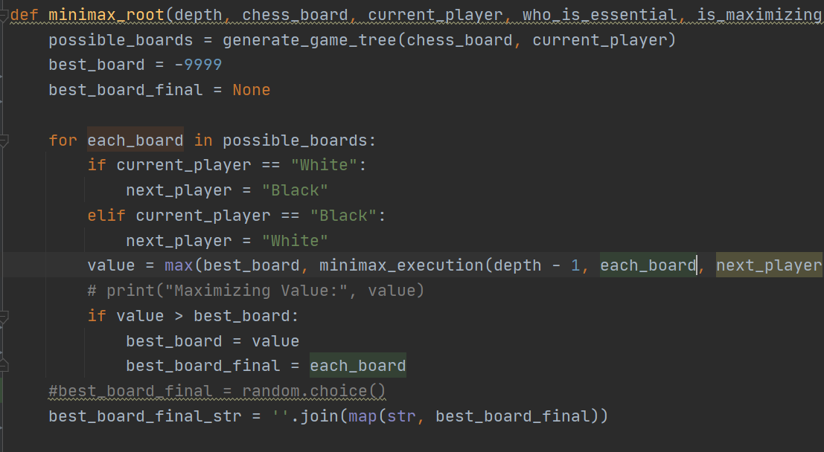
Minimax AI logic
Minimax Root, 2nd version:
Weakness:
AI plays faster but dumber
The player which ends any cycle or stalemate almost always loses

Slide 29
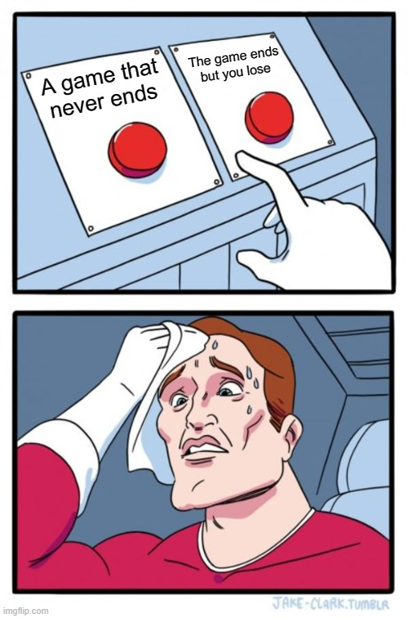

Minimax AI logic

Slide 30

Minimax AI logic
Minimax Root, 3rd version:
Make each move a list of equally scored ones, then randomly choose one
Go back and randomly choose a different one until the chosen move doesn’t result in a board state that that is already seen for more than 3 times
If all favorable moves are seen and tried, propose a draw

Slide 31





MiniChess vs Chess
Minichess
Chess

Slide 32
MiniChess vs Chess
Minichess
Can be many dimensions (3x3, 3x?, 5x5, up to 6x6~) and any setup
Game is won when:
Eliminating all opponent pieces
Opponent has no more legal moves
If King present, capturing the King can be specified as winning (or not)
No castling unless specified otherwise
Pawns always move 1 square unless specified
Chess
Is always 8 x 8 (64 squares)
Game is won by capturing the opponent’s King
King and Rooks can swap positions if none of them has moved yet (a.k.a. Castling)
Pawns can move 2 squares during their first ones
Pawn can promote to other pieces when reaching the other side of the board

Slide 33
MiniChess vs Chess
Minichess
Number of legal positions
167,303,246,916 unique legal positions in ALL 3x4 variants
3,677,542,994,054,890 unique legal positions in ALL 4x4 variants
Chess
Number of legal positions:
Estimated to be 10⁴³, and has been proved to be fewer than 10⁴⁷ with a game-tree complexity of approximately 10¹²³
10,000,000,000,000,000,000,000,000,000,000,000,000,000,000
It then makes sense that MiniChess is a logical starting point for chess programming.

Slide 34

MiniChess variants
From here on out, you will see several MiniChess variants.
All of them are named by myself.
Names might sound cool or funny, depending on what kind of person you are. Don’t mind them.

Slide 35
MiniChess variants
Each game variant is played exactly 999 times, with the following stats recorded:
White: How many times White won
Black: How many times Black won
Longest Game: The greatest number of turns any match took to conclude
Shortest Game: The least number of turns any match took to conclude
Average Game Length: How many turns on average does each match incur
Minimax AI search depth is:
4 on boards with <= 30 squares
3 on boards that are > 30 squares
Depth of 4 can still run on these boards, but 1 match would take about 10 minutes to finish
Recording would require up to 999*10/60/24 = 6.9375 = 7 days if depth was 4

Slide 36


MiniChess variant The House Of Commoners 3x5
In standard European Chess, Queen and King are called “Royal pieces”. The others must be commoners, then!
Pawn can attack b3, but does so by exposing Knight
Bishop protects the Pawn, preventing early Rook attacks
This variant name has nothing to do with the esteemed United Kingdom’s
~~or does it??

Slide 37



MiniChess variant The House Of Commoners 3x5
Type of White victories:
This variant name has nothing to do with the esteemed United Kingdom’s
~~or does it??

Slide 38



MiniChess variant The House Of Commoners 3x5
Type of Black victories:
This variant name has nothing to do with the esteemed United Kingdom’s
~~or does it??

Slide 39




MiniChess variant The House Of Commoners 3x5
Type of draws:
This variant name has nothing to do with the esteemed United Kingdom’s
~~or does it??

Slide 40

MiniChess variant The Queens’ Gauntlet 3x5
Queen is guarded by other pieces while in a good position to strike out on her own
The pieces accompanying the Queen are positioned to cross-shot any opponent that is made to run between them
King is present but the game is won by capturing all
The Queen's Gambit is a fantastic TV series. You should watch it.
Not that it has anything to do with this variant’s name sake~~

Slide 41



MiniChess variant The Queens’ Gauntlet 3x5
Type of White victories:
The Queen's Gambit is a fantastic TV series. You should watch it.
Not that it has anything to do with this variant’s name sake~~

Slide 42



MiniChess variant The Queens’ Gauntlet 3x5
Type of Black victories:
The Queen's Gambit is a fantastic TV series. You should watch it.
Not that it has anything to do with this variant’s name sake~~

Slide 43




MiniChess variant The Queens’ Gauntlet 3x5
Type of draws:
The Queen's Gambit is a fantastic TV series. You should watch it.
Not that it has anything to do with this variant’s name sake~~

Slide 44

MiniChess variant The Queens’ Gauntlet 3x5
I foresee a draw with 2 Queens.
I said a draw with 2 Queens.
…very well.

Slide 45

MiniChess variant Alternative Thai 4x8
Inspired by Thai Chess:
Makruk (Thai: หมากรุก; pronounced [màːk rúk]), or Thai Chess, is a chess variant descended from the 6th-century Indian chess chaturanga
This variant takes half its board mirrored, makes it capture-all, and swaps Queen and Bishop’s locations to encourage more diverse builds
To my shame, I can’t think of other interesting things to say about this variant ---- other than I enjoy it as much as I do Thai food.

Slide 46



MiniChess variant Alternative Thai 4x8
Type of White victories:
To my shame, I can’t think of other interesting things to say about this variant ---- other than I enjoy it as much as I do Thai food.

Slide 47



MiniChess variant Alternative Thai 4x8
Type of Black victories:
To my shame, I can’t think of other interesting things to say about this variant ---- other than I enjoy it as much as I do Thai food.

Slide 48

MiniChess variant Alternative Thai 4x8
Type of draws:
Why was there literally 0 draw?
To my shame, I can’t think of other interesting things to say about this variant ---- other than I enjoy it as much as I do Thai food.

Slide 49


MiniChess variant Alternative Thai 4x8
However, there are some edge cases:
WHY WOULDN’T THIS BE A DRAW?? 🤔
- Why did White move its Knight suicidally after almost 40 turns of maintaining safety?
- Was the map too big for duplicate states to appear?

Slide 50

MiniChess variant Alternative Thai 4x8
Is it because how I named this variant?

Slide 51
Win Rates and Balance
A common topic of debate is that the White player has an inherent advantage since s/he moves first and is therefore always ahead with her/his strategies
Since 1851, compiled statistics support this view
White consistently wins slightly more often than Black, usually scoring between 52 and 56 percent
However, all the MiniChess variants here have quite opposite results

Slide 52


The debate
♔
HEY BLACK,
If White really has first-move advantage,
Why does Black win more when both AIs employ Minimax on smaller boards??
WHY DO THESE WIN RATES FAVOR YOU
SO MUCH?

Slide 53
Some explanations
♔
HEY BLACK,
If White really has first-move advantage,
(from myself) Pure Minimax behaves differently from humans when playing chess:
Humans can delay exchanges by doing roundabouts
Minimax favors exchanges within the finite range that its search depth covers
Humans see strategies between combined pieces, while Minimax sees how much worth all pieces on the board are
Value of pieces could fluctuate overtime, but Minimax sees them as constant
If both players are purely thinking in materials, whoever moves second often comes out on top as s/he holds a better line structure
WHY DO THESE WIN RATES FAVOR YOU
SO MUCH?

Slide 54
Some explanations
♔
HEY BLACK,
If White really has first-move advantage,
"In terms of the mathematical games theory, chess is a game of complete information, and Black's information is always greater by one move.“
- Suba 1991
WHY DO THESE WIN RATES FAVOR YOU
SO MUCH?

Slide 55
Some explanations
♔
HEY BLACK,
If White really has first-move advantage,
If a Minimax AI has a depth of 4:
1 among many possible scenarios:
White exchanges its Knight at Turn 1 thinking it’d gain the best score by Turn 4
But if that Knight could become supremely important between say, Turn 7~11, White will have failed to see it before it is too late
Conversely, Black can vaguely measure what happens at Turn 5 while making the exchange
WHY DO THESE WIN RATES FAVOR YOU
SO MUCH?

Slide 56

Some explanations
In other words, this is how I think Minimax AI plays:

Slide 57
The next steps
Immediate future:
King check responses (to play on Capture-The-King variants)
Investigate what is causing the lack of draws on larger boards
(more distant) future:
Alpha-Beta Pruning (seems a must for AI to realistically play on 8x8 standard boards)

Slide 58
As a little bonus~~

Slide 59


MiniChess variant Silverman Knightly (4x5)
In 1981 mathematician David Silverman suggested this 4×4 chess variant.
To make the variant more playable, Silverman finally proposed to insert a row between pawns and use the board 4×5.
This variant replaces the King with Knight.

Slide 60

MiniChess variant Silverman Knightly (4x5)
White victories:

Slide 61


MiniChess variant Silverman Knightly (4x5)
Black victories:

Slide 62

MiniChess variant Silverman Knightly (4x5)
Once again, the number of draw is:

Slide 63

MiniChess variant Silverman Knightly (4x5)
Black wins. A lot.
♚

Slide 64


